Slide 1
Project Management
for Doctoral Students
Paul Warren
Retired Principal Technologist
Pilkington Group Limited
(A member of NSG Group)
8th November 2024

Slide 2
Agenda
My background in R&D
What is a project?
Why do we need to manage projects?
Project Management for Industrial work
Project Management for D. Phil studies

Slide 3
My background
1978 – 1989, 1992 - 1995 Materials Dept., Oxford University
Undergraduate, post-graduate, post-doc
1989 – 1991 College of Engineering, UCSB
Post-doc – composites and coatings
1995 – 1997 Materials Dept., Leeds University
Lecturer – ceramics, glasses, refractories
1997 – 2021 NSG (Pilkington) R&D, Lancashire
Mechanical Properties, Solar Power, Analytical Techniques
Now – retired
Scientific problems I didn’t have time to consider fully,
Mountain biking, playing the pedal organ

Slide 4
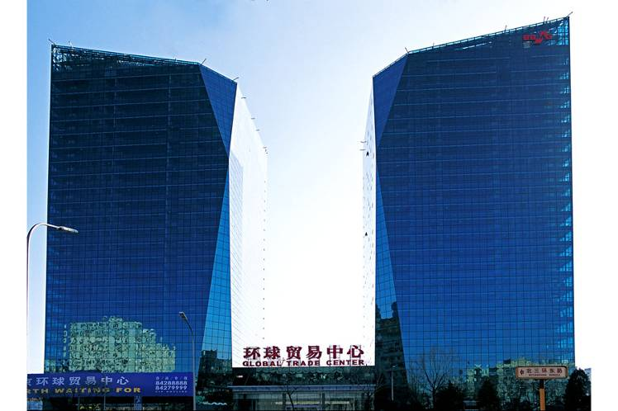
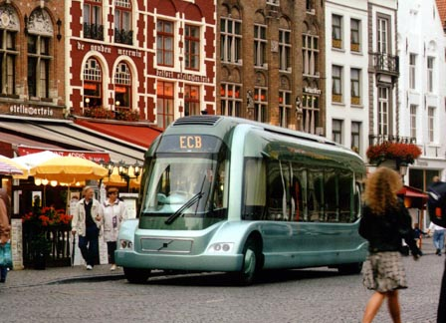
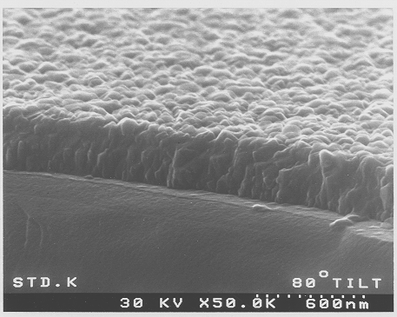
Pilkington/NSG
Invented the ‘float glass process’ – enabling production of low-cost, high-quality flat glass for buildings, transport, solar power…..
Invented a CVD process for coating glass as part of the float glass process
Various products – but especially transparent, conducting F-doped SnO2
Notes:
In buildings, glass used primarily to let light in and keep the elements out.
These days, control of the em spectrum is possible via tints/coatings. Solar radiation can be absorbed or reflected depending on climate/building orientation. Heat can be trapped inside buildings by use of double glazings and low-emissivity coatings. Surfaces
Electro-chromic windows - transmission can be controlled by the user.
Just under 50% of Pilkington’s output goes for buildings.

Slide 5
Some comments….
Prediction is very difficult, especially about the future.
(Neils Bohr)
It's not the plan that is important, it's the planning.
(Dr Graeme Edwards)
Planning is an unnatural process; it is much more fun to do something. The nicest thing about not planning is that failure comes as a complete surprise, rather than being preceded by a period of worry and depression.
(Sir John Harvey-Jones)
Trying to predict the future is like trying to drive down a country road at night with no lights while looking out the back window.
(Peter Drucker)

Slide 6
What is a project?
A project is a human activity that achieves a stated objective against a time scale
Usually….
- a definable start and end point
- a clear objective
- a fixed time scale
- requires resources
- a team of people, but one person is responsible
- little opportunity for practice/rehearsal
- involves change

Slide 7
When should a project be planned?
Always - no matter how small or unpredictable
A successful project will always allow time for planning - at the start and through the project
Unsuccessful projects leave the planning until things start to go wrong
Plans need to be appropriate to the size of the project
Notes:
Quantification of ‘appropriate’?
A float line - a £50m investment, 2500 tasks
R&D project automating part of the float process - £2m project, 100 tasks
An R&D preliminary investigation - a short (2 weeks) project, 1 page max of documentation

Slide 8
Key components of a plan
Why are you doing the work?
(ii) Who is the work for?
(iii) Consideration of Time/Cost/Quality
(iv) How do you know how well the work is going?
(v) What if the work doesn’t go to plan?

Slide 9
(i) Why are you doing the work?
Because it’s a new product you’ll be able to sell
Because it’s an improvement to your existing processes
Because it’s an exciting piece of new science
Because you want your D.Phil degree

Slide 10
(ii) Who are you doing the work for?
Concept of stakeholders - projects have various ‘interested parties’….
Sponsor
Gatekeepers
Project Manager
Project Team Members
Who are your stakeholders? Yourself, your Supervisor, the Department….?

Slide 11
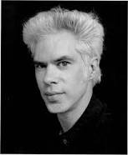
(iii) Time/Cost/Quality
Ideal
- On Time
- Under Budget
- Acceptable Quality
Time
Your project
Cost
Quality
“Fast, Cheap, and Good…pick two. If it’s fast and cheap it won’t be good. If it’s cheap and good it won’t be fast. If it’s fast and good it won’t be cheap. Fast, cheap, and good…pick (2) words to live by. ”
(Jim Jarmusch – independent film director)

Slide 12
(iv) Milestones/Quality
How do you know how well the project is going?
Set ‘Milestones’ - intermediate targets that need to be met before further progress can be made
How do you know whether a target has been met?
You need some measurement of ‘Quality’

Slide 13
(v) Contingency Planning
What do you do if your supervisor crashes his glider into a tree and is off for a while?
What do you do if your samples don’t arrive on time?
What do you do if the equipment you want to use is not available (either not working or heavily booked) for some time?
How will you finance yourself if you don’t finish in 3.5 years?

Slide 14
Stage-Gate Process
Stage 0
Stage 1
Stage 2
Stage 3
Stage 4
Stage 5
Idea Evaluation
Concept
Definition
Evaluate
Develop
Implement
Launch
1
2
3
4
5
Ideas
Winners
Gate 0
Gate 1
Gate 2
Gate 3
Gate 4
Gate 5

Slide 15
What things does industry consider?
Market Analysis
Customer need/benefit, Preliminary product/process description
Initial cost benefit analysis (sales/volume, existing product impact etc)
Competitor position/response
Technical Analysis
Preliminary product/process specification, Technical feasibility & risk analysis
Patent issues, Alternative technologies/options (JV, licensing etc.)
HS&E assessment
Manufacturing Analysis
Potential manufacturing location(s), Compatibility with existing processes
Impact on existing capacity, Logistics (Raw Material -> customer delivery)
Financial Analysis
Development Costs, Capital Costs
Product/Process costs, Cost of manufacture, Average price/profit/return on sales

Slide 16
Some Project Tools
Work Breakdown Structures
Gantt Charts
Critical Path Analysis (PERT Charts)
Contingency Planning
Failure Mode Effects Analysis
Pareto Charts
(ChatGPT?)

Slide 17
Work Breakdown Structure
Consists of….
One high-level Objective
Some Work Packages
Lots of Tasks

Slide 18
Work Package
Work Package
Work Package
Tasks
Tasks
Tasks
Objective
Tasks
Tasks
Tasks
Work
Breakdown
Structure
Work Package
Work Package
Work Package

Slide 19
Gantt Charts
Similar information to a Work Breakdown Structure
Crucial difference is the addition of a timeframe
No time-dependencies shown - so direct Critical Path Analysis cannot be computed.
No direct consideration of Quality

Slide 20
Gantt Charts

Slide 21
Exercises 1, 2
Construct (i) a Work Breakdown Structure, and (ii) a Gantt chart, for:
‘Getting a good literature review handed in by 30th September 2025’
Some points to consider: - Supervisor availability in summer 2025? - Mastery of electronic searching, What information already exists in your research group? etc etc
For the purpose of this exercise – treat the topic as the Objective itself. So – 1 Objective, a couple of Work Packages, a few Tasks under each Work Package heading.

Slide 22
Example - My D.Phil project
Objective - Get my D.Phil qualification
Thesis title - ‘An investigation of the relationship between the electrical and mechanical properties of non-metals’
Work Packages – generic (for an experimental project)
Literature review
(b) Specimen Preparation/Experimental techniques
(In my case - X-ray diffraction, cutting, polishing, indentation, dislocation velocity measurement)
(c) Specific scientific work packages here
(d) Produce thesis, attend viva

Slide 23
Example - My D.Phil project
Work Packages - specific scientific
(1) Indentation of {001}, {111} faces of GaAs as a function of temperature, using Knoop and Vickers indenters
(2) Measure dislocation velocities
(3) Interpretation of dislocation velocity measurements - and hence….
(4) Interpretation of indentation results

Slide 24
Example - My D.Phil project
Work Package (2) - Dislocation velocity measurements
Tasks
Production of dislocation sources in samples - small-scale scratches at high temperature
Mechanical loading of samples at high temperatures - design of apparatus
Measurement of velocity

Slide 25
Example - My D.Phil project
Work Package (3) - Dislocation velocity interpretation
Tasks
Which types (screw, 60°, α, β) of dislocation loop have I produced?
How will surface-nucleated dislocation loops behave under the stress field that I’ve applied?
Differences in dislocation motion for N-type, intrinsic, P-type GaAs - interpretation in terms of electronic properties
How do dislocations of different type (and hence velocity) move under/around indenter?

Slide 26
Sample
Preparation
Dislocation velocity
measurements
Interpretation
Viva
X-ray
diffraction
Dislocation
production
Tasks
Tasks
Crystal cutting
Stressing
dislocations
Crystal polishing
Crystal etching
Velocity
measurements
Health and Safety
Obtain
Thesis
Internet
Indentation
Co-workers
Library
Dislocation
Velocity
Tasks
Tasks
Work
Breakdown
Structure
Literature
Review
Experimental
Techniques
Indentation
measurements
Write-up

Slide 27
Summary
Project Management is something you need to do - whether you intend to work in industry or services, or to remain in academic life.
The level of Project Management/Planning needs to be appropriate to the tasks.
There are plenty of tools available to assist you.
Work Breakdown Structures and Gantt Charts are probably most appropriate for D. Phil work.
Use Milestones/Quality measurements to assess progress.
The Project Plan can be changed!

Slide 28
Gantt Chart

