Slide 1
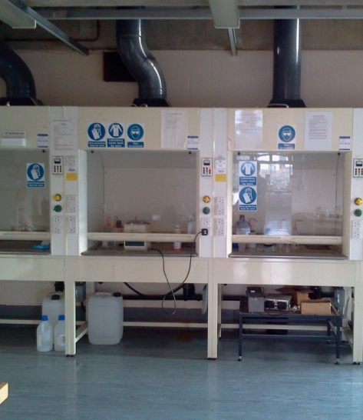
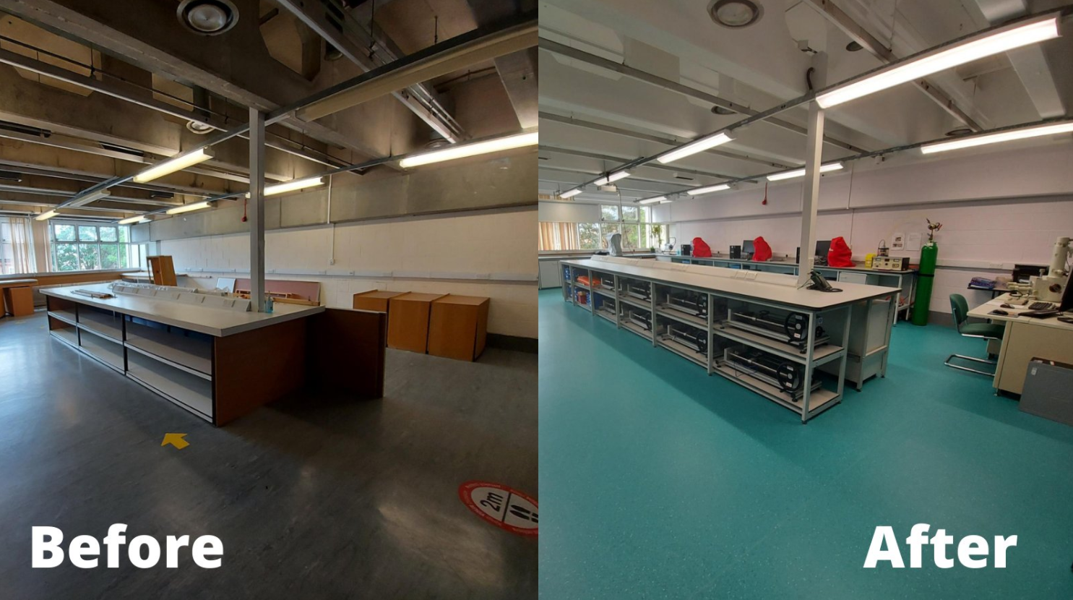
Junior Demonstrator Workshop
Diana Passmore & Bradley Young
(slides adapted from many previous TA’s: Laura Wheatley, Mike Goode, Dr Ben Jenkins and Megan Carter, to name a few!)
Notes:
DP & BY

Slide 2
Overview
Undergraduate labs in Materials Science
Important people
Purpose
Schedules
Groupings
Topics
The role of the Junior Demonstrator
What it is
What it isn’t
Some advice
Possible UG lab scenarios
Notes:
DP

Slide 3
The Purpose of UG Labs
Labs provide essential training in practical scientific skills, conducting work independently from written instructions to report writing
Labs support the academic lecture course series throughout the year
Labs are EXAMINED coursework towards either Preliminary or Final exams
Notes:
DP
Note that students the practicals don’t always match up with lectures

Slide 4
Undergraduate Degree Structure
Year | Module | Assessment
1 | MS1 – Structure of Materials | Written Summer ‘Prelims’ Exams 400 / 500 marks
 | MS2 – Properties of Materials
 | MS3 – Transforming Materials
 | MMES - Maths for Materials and Earth Scientists
 | Practical Labs | Written assessment of lab reports 50 / 500 marks
 | Crystallography Classes | Written assessment during classes 50 / 500marks
2 | GP1 - Structure and Transformation of Materials | Written Summer ‘Finals’ Exams at end of 3rd year 400 / 1200 marks
 | GP2 - Electronic Properties of Materials
 | GP3 - Mechanical Properties of Materials
 | GP4 - Engineering Applications of Materials
 | Practical Labs | Written assessment of lab reports 60 / 1200 marks
 | Industrial Visits, Business Module | Written assessment of reports 40 / 1200 marks
3 | OP1 – Materials Options Paper 1 | Written Summer ‘Finals’ Exams at end of 3rd year 200 / 1200 marks
 | OP2 – Materials Options Paper 2
 | Team Design Project | Written assessment of reports 50 / 1200 marks
 | Characterisation / Modelling Module | Written assessment of reports 50 / 1200 marks
4 | Masters (Part II) Project | Written assessment of thesis 400 / 1200 marks
Notes:
DP
This is changing this year – but still, the points stand about labs as good preparation for part ii

Slide 5
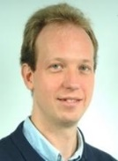
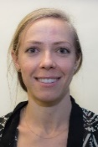
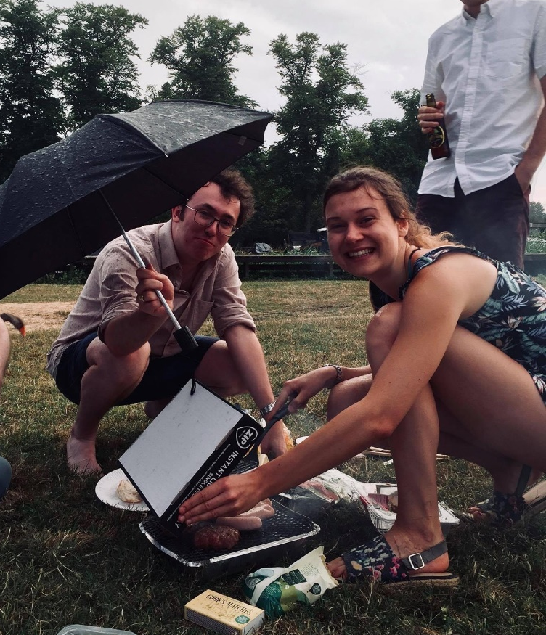
Important People
Prof Peter Nellist– Practical Class Organiser (PCO)
Diana Passmore – Practical Class Technician (PCT)
Academic Lead
Senior Demonstrators (SD’s)
Deputy SD’s
Junior Demonstrators/Teaching Assistants (JD’s/TA’s)
The Students (≈38-48 each year)
Education Support Team
Philippa Moss etc.
Notes:
DP

Slide 6
UG Labs Schedule
14:00 – 17:00
First year (2 days):
Thursday & Friday (6hrs/wk)
Excluding some introductory labs in MT wk1-2
Weeks 1-4 TT
Second year (3 days):
Monday – Wednesday (9hrs/wk)
Special timetable in TT
Ensure you are available for the whole duration (each afternoon) of the practical
TA’s should aim to arrive at least 10 minutes before the start of labs
Practical timetable is reviewed annually
Each practical runs in a 2 week block
Notes:
DP

Slide 7
UG Lab Groups
Student’s work in groups of 2 – 3
Generally grouped by college but not always
Designed to encourage and teach
Will undoubtedly include a mixture of abilities, personalities, approaches, genders
Notes:
DP

Slide 8
UG Lab Topics – Year 1
Practical 1P1a Intro to Computing
Practical 1P1b Intro to Microscopy
Practical 1P2 Intro to LabVIEW
Practical 1P3 Young’s Modulus & Stress Analysis
Practical 1P4 Metallography
Practical 1P5 Polymers - Molecular Weight Effects
Practical 1P6 Thermal Analysis
Practical 1P7 Bubble Raft
Practical 1P8 Electrode Potentials
Practical 1P9 Energy Levels and Band Gaps
Practical 1P10 Fabrication & Tensile Testing
http://www.materials.ox.ac.uk/teaching/ug/ugpracticals.html
Notes:
DP
Practical Scripts can be found on the department website

Slide 9
UG Lab Topics – Year 2
Practical 2P1 Materials Selection
Practical 2P2 Steels
Practical 2P3 Extrusion
Practical 2P4 Casting
Practical 2P5 Diffusion
Practical 2P6 Dislocations and Plasticity
Practical 2P7 Corrosion
Practical 2P8 Mechanical Properties of Polymers
Practical 2P9 XRD Detective
Practical 2P10 SEM and Fracture
Practical 2P11 Transmission Electron Microscopy (TEM)
Practical 2P12 Semiconductor Devices
http://www.materials.ox.ac.uk/teaching/ug/ugpracticals.html
Notes:
DP

Slide 10
UG Practical Assessments
Lab Notebook:
completed during the practical hours
stay in the lab
concise information about what happened in lab
assessment type for majority of practicals
marked out of 3 (by SD)
Lab Report:
3 weeks to complete (at home)
in the form of an Acta Materialia article
usually 1x report per term
marked out of 13 (by SD)
Other:
introductory 1st year labs not assessed (1P1a, 1P1b, 1P2)
poster presentation (2P1 Material Selection)
Notes:
DP

Slide 11
The Role of the SD
To write/update lab script for the students to follow
To introduce and explain the relevance of the lab
To tell the students the key deliverables they are looking for
To instruct the TA’s if there are special themes they want highlighted by the students
To be around in the labs to answer academic questions, ~ 1 hour per day (not fixed)
To read and mark the lab notebooks/reports
Notes:
DP

Slide 12
The Role of the JD/TA is... (1)
To familiarise themselves with the practical (practical script, equipment, frequent problems, data analysis)
(For new JDs) complete the lab and produce a data set – paid!
Assist PCT (Diana) to:
set up/down each practical
encouraging safe, respectful and professional behaviour in the labs
concluding the labs in a timely fashion
To answer reasonable questions from students
Notes:
Be proactive!

Slide 13
The Role of the JD/TA is... (2)
To assist student in becoming effective experimental scientists with:
proper lab discipline, behaviour and time management
effective team-work and communication skills
correct use of lab notebooks (most examined and available to the examiners for inspection)
To assist students with experimental equipment
To develop themselves in their communication and teaching skills.
Comply with the rules of the lab!
Notes:
DP

Slide 14
The Role of the JD/TA is not...
To give students the ‘answers’ to the lab
To do any work for the students or tell the students how to approach the tasks
To tell them if they’ve gotten something ‘right’ or ‘wrong’
To earn some quick money by baby-sitting a group of young adults / to catch-up on reading
Notes:
DP

Slide 15
A few words of advice
Make sure to spend time getting familiar with your practical(s)
It is much easier to deal with problems if you understand the practical, apparatus and data analysis!
You get paid for the training time!
Be proactive and talk to all the groups regularly
This often helps to identify problems before they arise
Enjoy yourself!
Notes:
DP

Slide 16
Application Process
Application form + reference from supervisor
You will receive:
application form
job description
practical schedules
practical's that are available for selection
Due Date: 5pm Friday 17th Feb 2023

