Slide 1
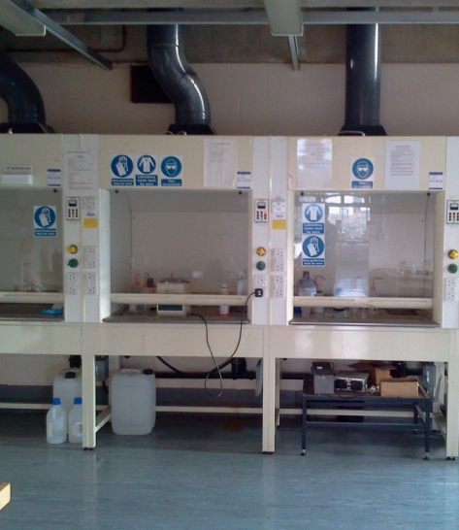
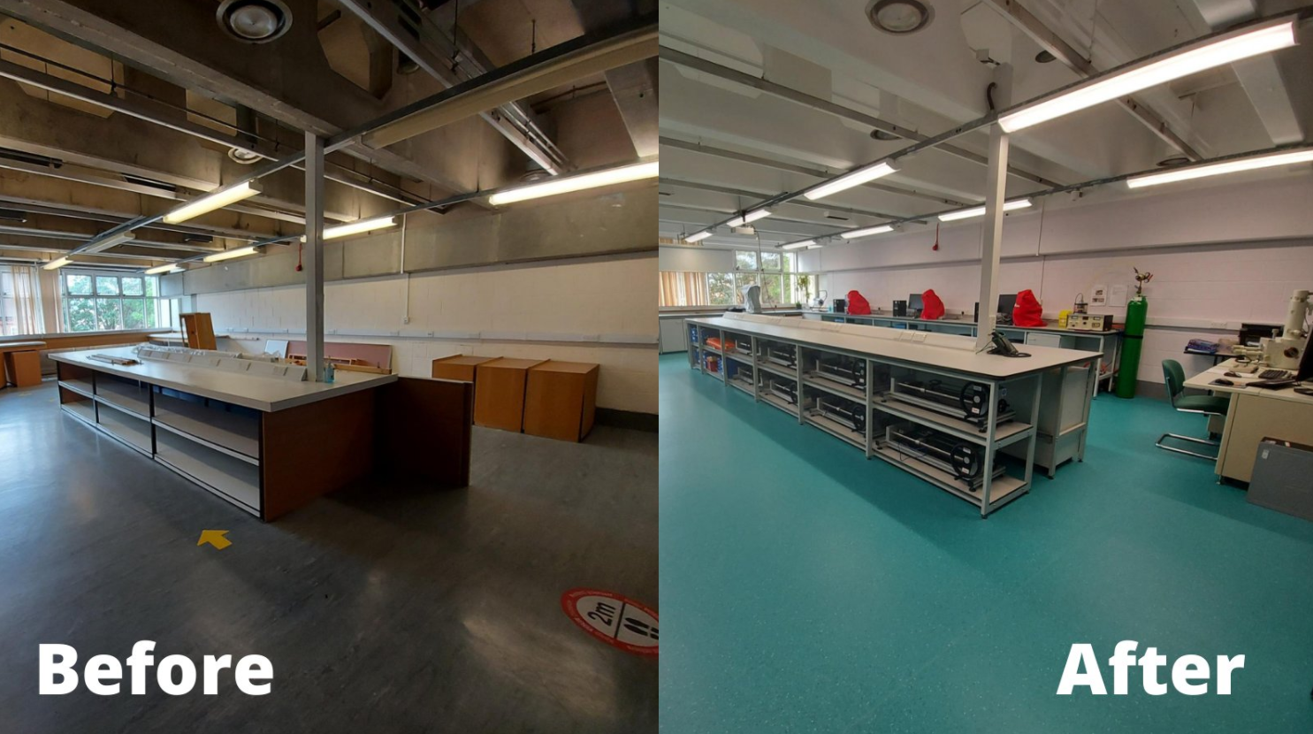
Junior Demonstrator Briefing
Laura Wheatley & Michael Goode
(Slides Adapted From Dr Ben Jenkins and Meg Carter)
Notes:
LW and MG

Slide 2
Overview
Undergraduate labs in Materials Science
Important people
Purpose
Schedules
Groupings
Topics
The role of the Junior Demonstrator
What it is
What it isn’t
Some advice
Possible UG lab scenarios
Notes:
LW

Slide 3
Ice Breaker
What is your best memory (or worst) of your undergraduate labs?
(Keep it pc!)
Notes:
MG + LW

Slide 4
The Purpose of UG Labs
Labs provide essential training in practical scientific skills, conducting work independently from written instructions and report writing
Labs support the academic lecture course series throughout the year
Labs are EXAMINED coursework towards either Preliminary or Final exams
Notes:
LW
Note that students the practicals don’t always match up with lectures

Slide 5
Undergraduate Degree Structure
Year | Module | Assessment
1 | MS1 – Structure of Materials | Written Summer ‘Prelims’ Exams 400 / 500 marks
 | MS2 – Properties of Materials
 | MS3 – Transforming Materials
 | MMES - Maths for Materials and Earth Scientists
 | Practical Labs | Written assessment of lab reports 50 / 500 marks
 | Crystallography Classes | Written assessment during classes 50 / 500marks
2 | GP1 - Structure and Transformation of Materials | Written Summer ‘Finals’ Exams at end of 3rd year 400 / 1200 marks
 | GP2 - Electronic Properties of Materials
 | GP3 - Mechanical Properties of Materials
 | GP4 - Engineering Applications of Materials
 | Practical Labs | Written assessment of lab reports 60 / 1200 marks
 | Industrial Visits, Business Module | Written assessment of reports 40 / 1200 marks
3 | OP1 – Materials Options Paper 1 | Written Summer ‘Finals’ Exams at end of 3rd year 200 / 1200 marks
 | OP2 – Materials Options Paper 2
 | Team Design Project | Written assessment of reports 50 / 1200 marks
 | Characterisation / Modelling Module | Written assessment of reports 50 / 1200 marks
4 | Masters (Part II) Project | Written assessment of thesis 400 / 1200 marks
Notes:
This is changing this year – but still, the points stand about labs as good preparation for part ii
MG

Slide 6
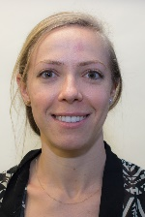
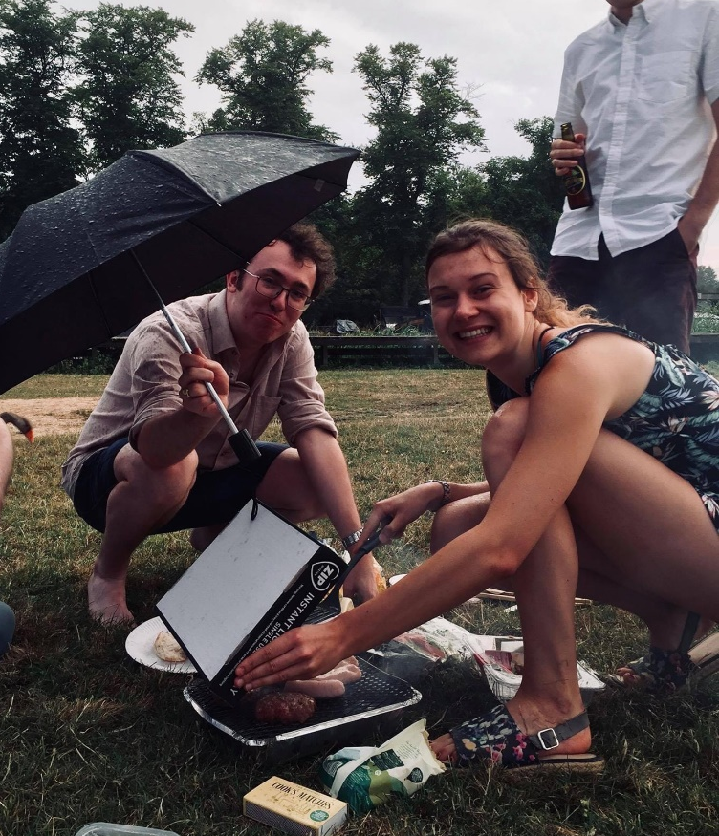
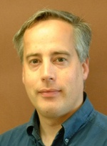
Important People
Prof Sergio Lozano-Perez – Practical Class Coordinator
Diana Passmore – Practical Class Technician (PCT)
Senior Demonstrators
The Students (≈40-50 each year)
Other Junior Demonstrators
Paul Warren etc. – Departmental IT
itsupport@materials.ox.ac.uk
Notes:
LW
Input silly mike and laura photos

Slide 7
UG Labs Schedule
First year UGs:
Thursday & Friday 14:00 – 17:00 alternate weeks (MT & HT)*
*Excluding some introductory labs in MTwk1
PLUS two afternoons (assorted days) in the first half of TT
Second year UGs:
Monday – Wednesday afternoons alternate weeks*
*Except Trinity term which has a special timetable
Junior demonstrators should aim to arrive at least 10 minutes before the start of labs
Labs may not happen in the same order as previous years
Notes:
LW
Try to keep term week afternoon free until you know when your lab will be scheduled

Slide 8
UG Lab Groups
Students work in groups of three with the occasional pair
Generally grouped by college but not always
Designed to encourage and teach teamwork
Will undoubtedly include a mixture of abilities, personalities, approaches, genders
Notes:
MG

Slide 9
UG Lab Topics – Year 1
Practical 1P1a Intro to Computing
Practical 1P1b Microscopy
Practical 1P2 Introduction to LabView
Practical 1P3 Young’s Modulus & Stress Analysis
Practical 1P4 Metallography
Practical 1P5 Polymers - Molecular Weight Effects
Practical 1P6 Thermal Analysis
Practical 1P7 Bubble Raft
Practical 1P8 Electrode Potentials
Practical 1P9 Energy Levels and Band Gaps
Practical 1P10 Fabrication & Tensile Testing
http://www.materials.ox.ac.uk/teaching/ug/ugpracticals.html
Notes:
LW
Not necessarily order

Slide 10
UG Lab Topics – Year 2
Practical 2P1 Materials Selection
Practical 2P2 Steels
Practical 2P3 Extrusion Casting
Practical 2P4 Casting
Practical 2P5 Diffusion
Practical 2P6 Dislocations and Plasticity
Practical 2P7 Corrosion
Practical 2P8 Mechanical properties of polymers
Practical 2P9 XRD Detective
Practical 2P10 SEM and Fracture
Practical 2P11 Transmission Electron Microscopy
Practical 2P12 Semiconductor Devices
http://www.materials.ox.ac.uk/teaching/ug/ugpracticals.html
Notes:
MG

Slide 11
UG Lab Notebooks
Most practicals the students fill in their lab notebook in the practical session
Materials Selection – poster
Some labs require a report after the lab – ask Sergio for which labs. The marking is down to the SD
Notes:
LW

Slide 12
Group Exercises
Split into groups:
What makes the best teachers/educators effective?
Think of a couple of examples of bad teaching
In your experience, what makes a good/bad demonstrator?
Couple of minutes to think!
Notes:
Good bad teaching
Good bad demonstrator
LW & MG

Slide 13
Potential Answers

Slide 14
The Role of the Senior Demonstrator
To write lab handout for the students to follow
To introduce and explain the relevance of the lab
To tell the students the key deliverables they are looking for
To instruct the JDs if there are special themes they want highlighted by the students
To be around in the labs to answer academic questions, around an average of one hour per day (not fixed)
To read and mark the written reports
Notes:
Good idea to understand differences between demonstrators – written outside, read it
MG

Slide 15
The Role of the Junior Demonstrator is... (1)
To familiarise themselves with the practical and the equipment in advance of the lab session, including reading the online handout
(For new JDs) doing a practice run of the lab – paid!
To oversee delivering the SDs requirements
To assist Diana in encouraging safe, respectful and professional behaviour in the labs
To assist Diana in concluding the labs in a timely fashion
To answer reasonable questions from students
Notes:
LW
Be proactive with Diana and SD - training
Two slides
What is reasonable – slide of questions?

Slide 16
What are reasonable questions?
“What should we do first?”
“Is one measurement enough?”
“We are unsure if we have set up our testing equipment properly, please could you check?”
“Do these results look right to you?”
What should you do if you are asked a question that you don’t know the answer to?
Notes:
LW and MG

Slide 17
The Role of the Junior Demonstrator is... (2)
To assist student in becoming effective experimental scientists with:
proper lab discipline, behaviour and time management
effective team-work and communication skills
correct use of lab notebooks (not examined but available to the examiners for inspection)
To assist students with experimental equipment
To develop themselves in their communication and teaching skills.
Comply with the rules of the lab, e.g. clothes and footwear
Notes:
MG

Slide 18
The Role of the Junior Demonstrator is not...
To give students the ‘answers’ to the lab
To do any work for the students or tell the students how to approach the tasks
To tell them if they’ve gotten something ‘right’ or ‘wrong’
To earn some quick money by baby-sitting a group of young-adults / to catch-up on reading
Notes:
LW

Slide 19
A few words of advice
Make sure to spend time getting familiar with your practical(s)
It is much easier to deal with problems if you understand the practical and apparatus!
You get paid for the training time!
Be proactive and talk to all the groups regularly
This often helps to identify problems before they arise
Enjoy yourself!
Notes:
MG

Slide 20
Possible UG Lab Scenarios (1)
A student doesn’t understand the handout’s instructions
You see someone copying / cheating
An accident/near miss occurs
A student is in the IT room completing tute-work for a deadline
A student leaves the lab unannounced to go smoke / to the vending machines
You see a student about to do something without the required PPE
Notes:
LW
(more straightforwards scenarios where there is a definite answer (or at least an official one)

Slide 21
Possible UG Lab Scenarios (2)
One person in a group is doing no work
One person in a group is doing all the work
A student is checking emails / listening to music / playing with a smart-phone in the lab
You think a student / group are rushing their work just to leave early
Several groups in the lab all need help at the same time
You see a group doing the practical/analysing their data incorrectly
Notes:
MG
Safety?
Equipment problems
What to do if you see a group doing something clearly wrong
Group look like they won’t finish

Slide 22
Real Scenario
You are approaching the end of day two of a three day lab. You have concerns that one group will struggle to finish on time. They have taken multiple measurements for 2 out of 5 samples, but have not yet taken any measurements on the other three samples. They seem more concerned with taking multiple measurements for each sample.
What would you do?

Slide 23
Any Questions?
Thank you for listening

